Slide 1
Library CodeX
GROUP 1
Dean Ferris
Kalkidan Tamirat
Minpyo Kim
Thong Ton

Slide 2

Library codex introduction and team management
Dean Ferris and Minpyo Kim ➔ Front-End
Kalkidan Tamirat and Thong Ton ➔ Back-End
Team Lead: Dean Ferris
All team members communicated via canvas, email and phone/video, in addition to onsite & offsite meetings.

Slide 3
Purpose of program
Minpyo Kim

Slide 4
Library Codex
Library CodeX is a program designed for Library environments for book inventory.
Future versions of Library CodeX will book-keeping and administration & human resources.

Slide 5
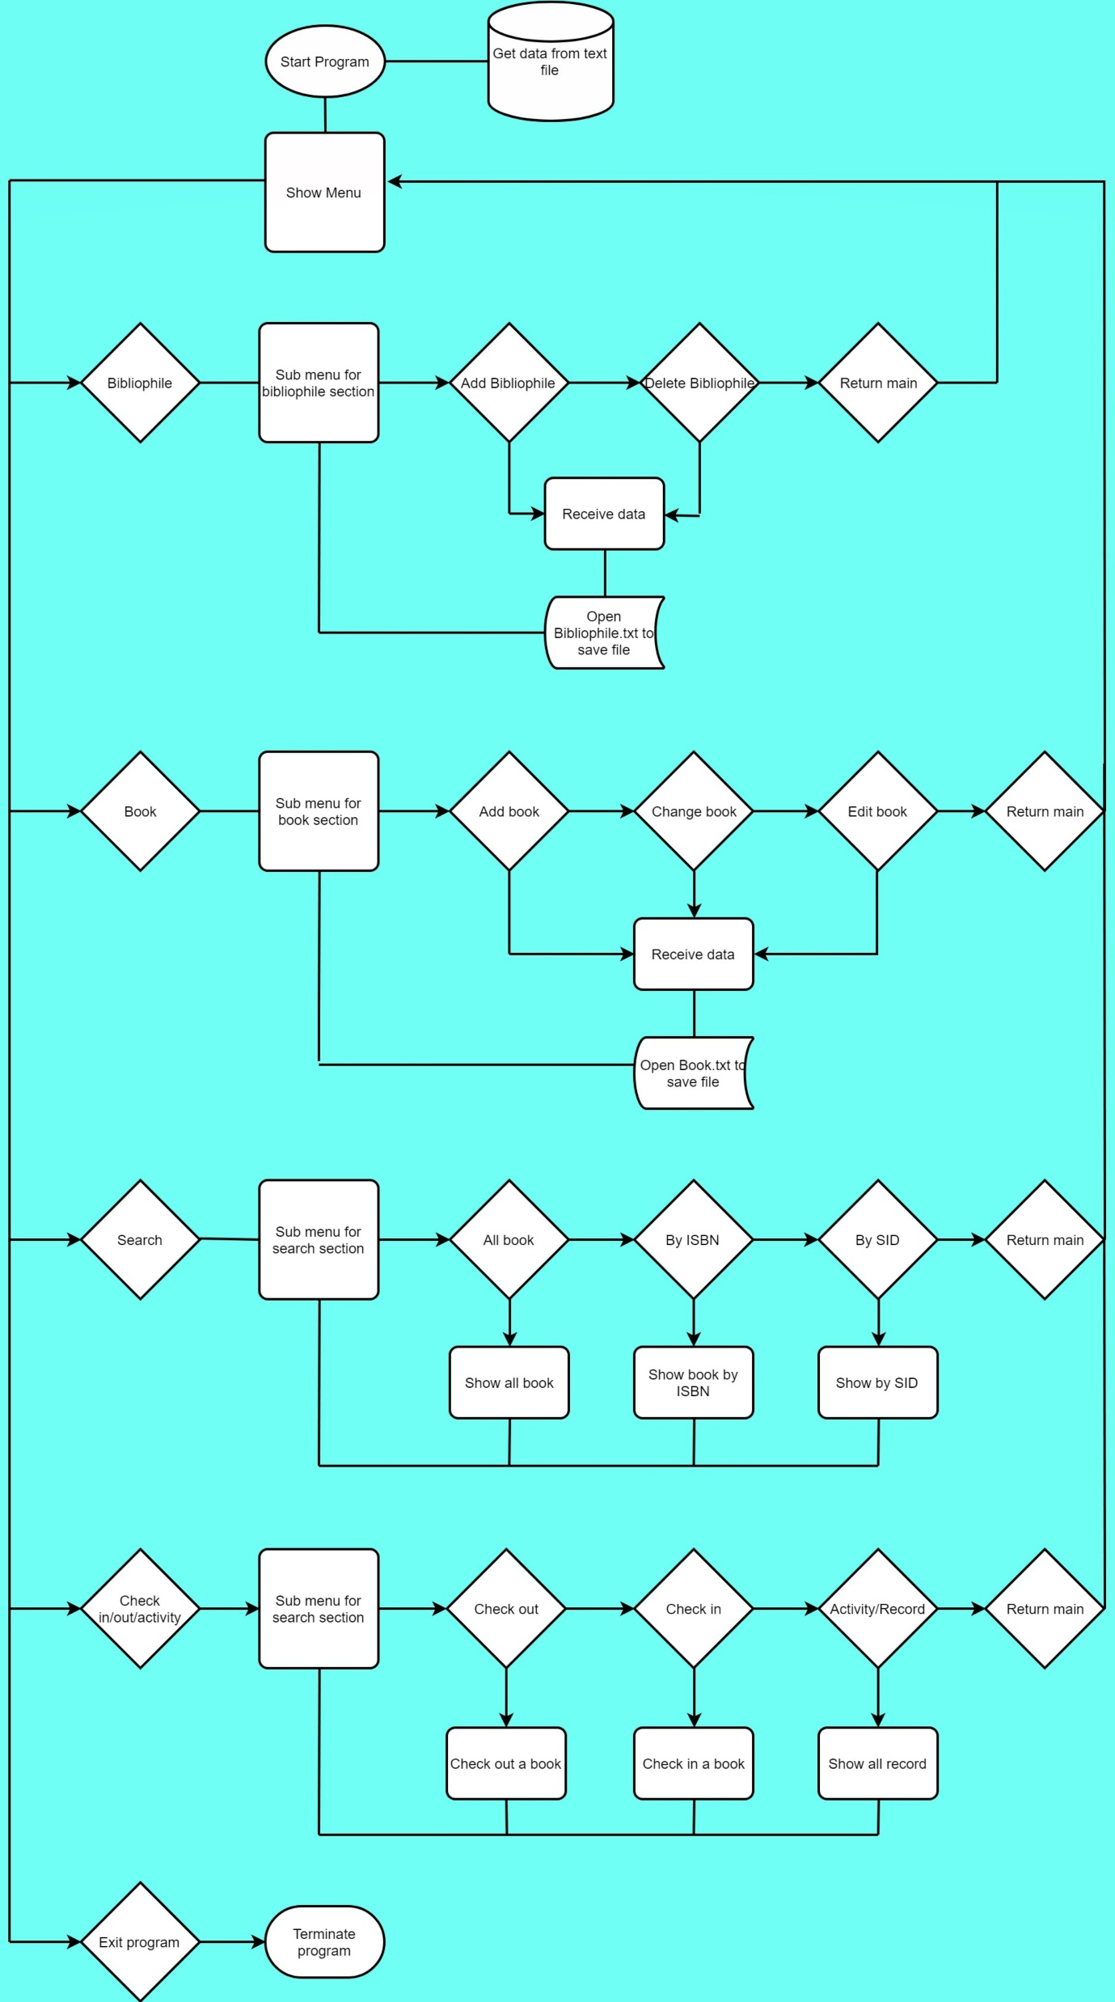
Library codex flow

Slide 6
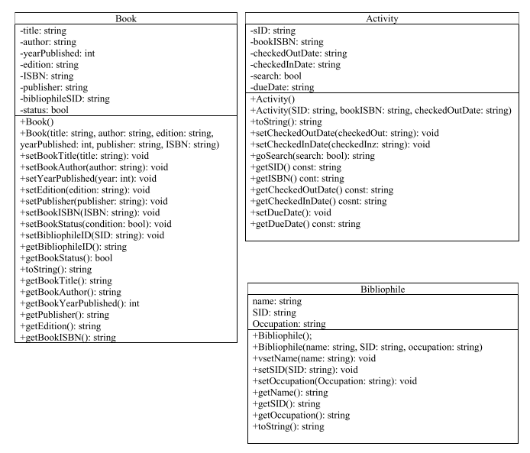
Library codex Uml diagram

Slide 7
Demonstration
Thong Ton

Slide 8
Search activity
Dean Ferris

Slide 9
Bullet proofing
Kalkidan Tamirat

Slide 10
Questions?

